Slide 1
Analyzing Urban Green Space Accessibility and Demographics in Baltimore
Submitted by Krishna Chaitanya Mummadi
MT68291
Professor: Eli Pousson

Slide 2
Introduction
This project analyzes park accessibility in Baltimore and its relationship with demographics such as population density, race, and income. Uneven park access could be due to factors such as economic disparities, urban development patterns or other decisions, have resulted in uneven park access, which is vital for physical, mental, and social well-being. Walkability and demographic analysis can identify access gaps and inform strategies for equitable green spaces.
“The right to a quality environment is not a privilege, it is a necessity for all people.” – Anonymous

Slide 3
Goals
Assess accessibility to parks and green spaces in Baltimore City, focusing on their proximity within tracts.
Analyze the ratio of park area to tract area, identify tracts without parks, and measure the distance from tract centroids to the nearest parks to highlight disparities in access.
Perform isochrone analysis to evaluate park accessibility using various travel modes (walking, cycling, driving).
Examine equity in park accessibility by analyzing the relationship between demographic factors and green space distribution.
Learn and apply advanced mapping functions, enhancing skills in interactive tools like Leaflet and Mapview.
Improve proficiency in working with open-source spatial data and writing functions to enhance analytical outputs and visualizations.

Slide 4
Data Sources to Support the Project Goals
Open-Source Data from TIGER/Line (Tigris): To obtain tract-level geographic and demographic data.
JSON Files from Open Baltimore: To access local datasets, including information about parks and tracts.
Tidy Census: To integrate U.S. Census data, providing demographic and socioeconomic details for spatial analysis (requires API key).
OpenRouteService: To perform isochrone analysis and evaluate accessibility using various travel modes (requires API key).
Leaflet and MapView Plugins: To visualize and interact with spatial data effectively

Slide 5
Project Approach
Data Collection:
Use TIGER/Line (Tigris) for tract-level data, Open Baltimore JSON files for parks and tracts, Tidy Census for demographics, and OpenRouteService for isochrone mapping.
Spatial Analysis:
Measure park proximity, perform isochrone analysis to evaluate coverage for selected parks and locations using various travel modes, and calculate park-to-tract area ratios to identify disparities.
Visualization:
Use Leaflet, MapView, ggplot, bar graphs, and boxplots to display accessibility and spatial relationships.
Equity Assessment:
Visually correlate park access with demographic factors to identify underserved areas.
Insights and Explanation:
Analyze and interpret the existing situation of parks and provide explanations based on the findings to support conclusions.

Slide 6
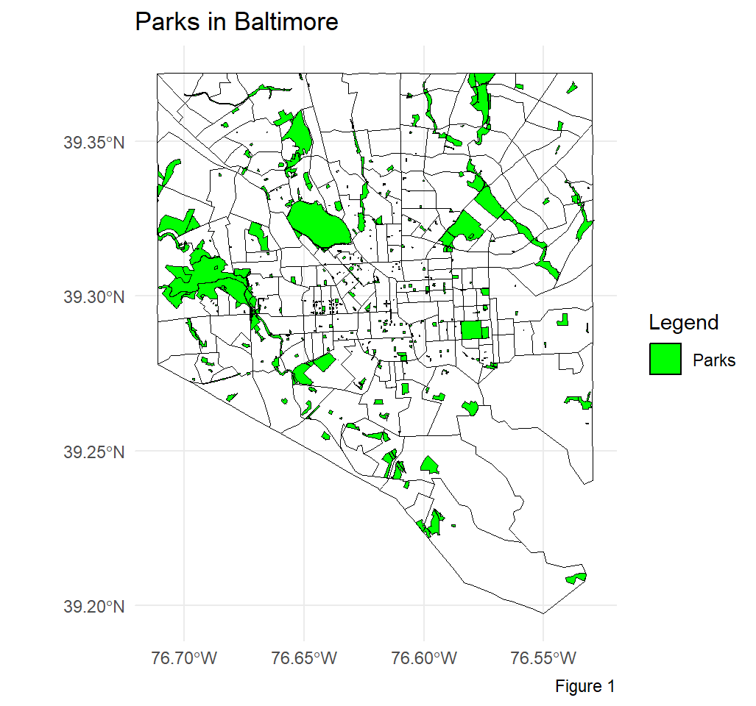
The map illustrates an uneven distribution of parks across Baltimore.
Parks are more densely clustered in the central and western regions of the city.
The southern and northeastern areas have noticeably fewer parks, indicating potential gaps in accessibility.
This map highlights areas that could be prioritized for future green space development to address disparities.

Slide 7
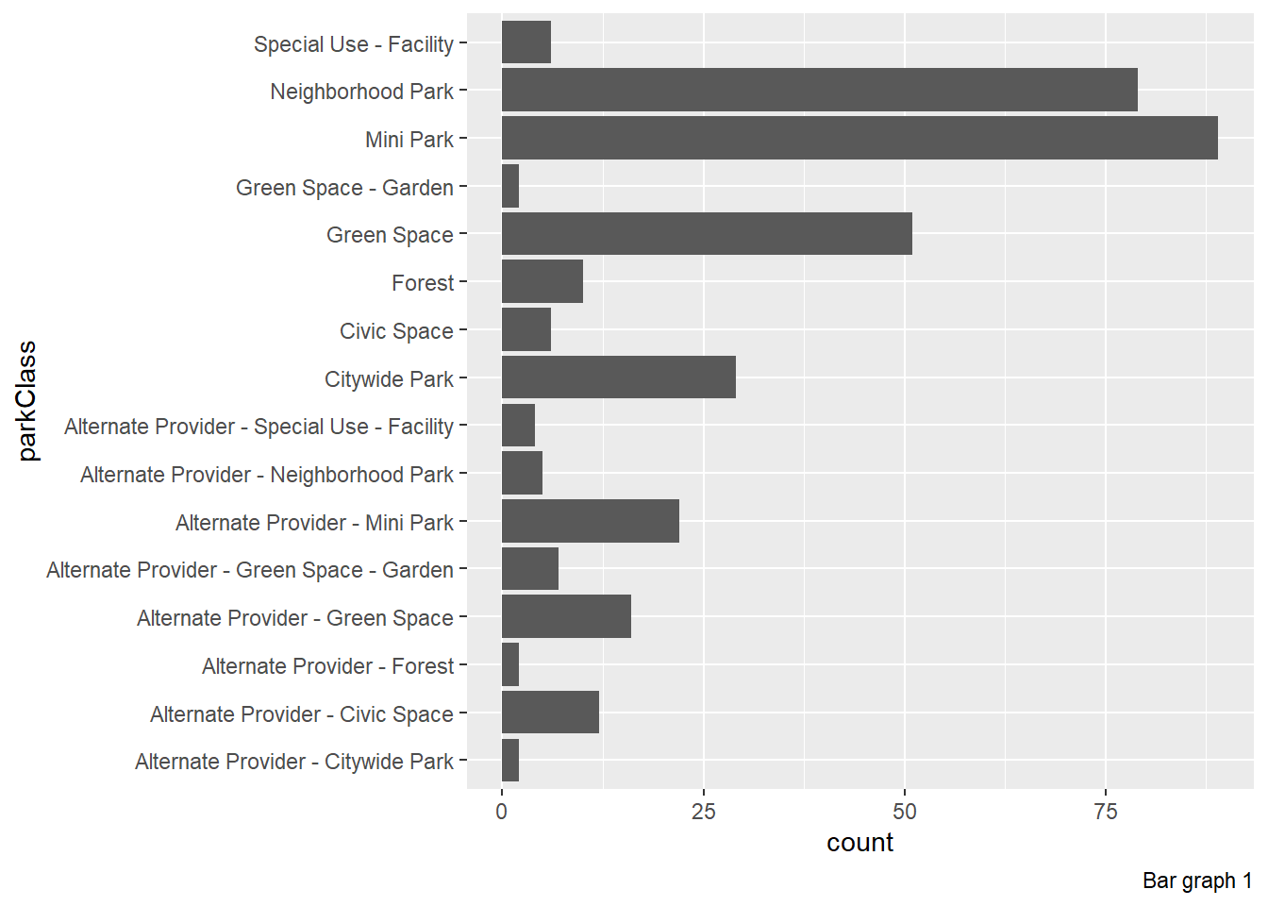
The parks dataset is obtained from Open Baltimore, it have various park types, the majority are minipark, neighborhood park and green space, here alternate provider mean private entity which manages the green space

Slide 8
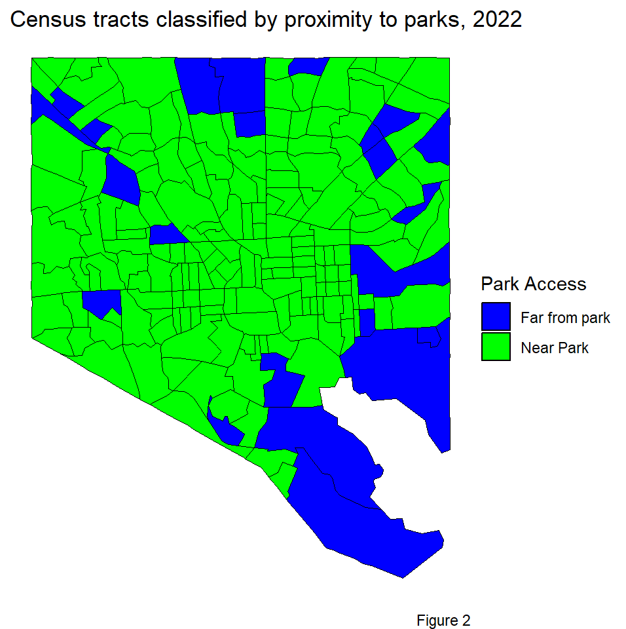
Inspired by the Urban Spatial project, this analysis evaluates Baltimore's park accessibility by measuring the distance from tract centroids to the nearest park.
Parks are represented as points, and tracts are classified as "Near Park" or "Far from Park" using an 800-meter threshold, revealing disparities.

Slide 9
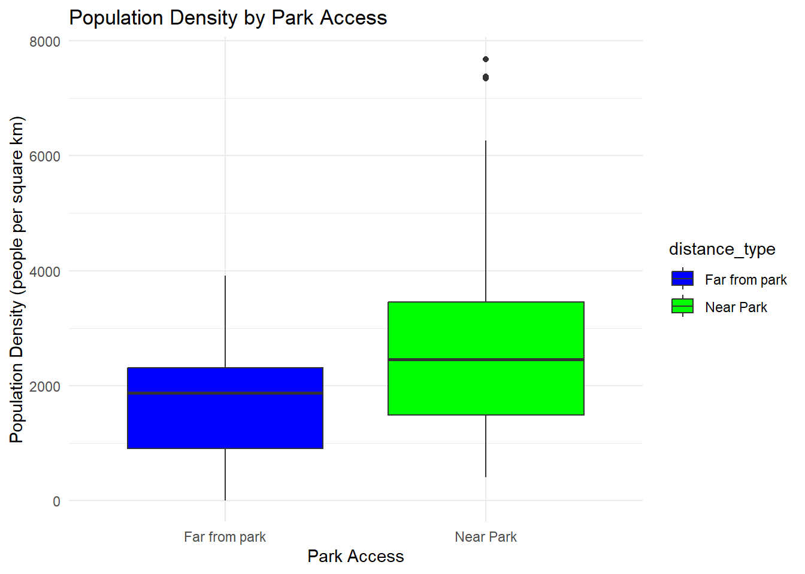
This boxplot shows that census tracts near parks generally have higher population densities compared to tracts far from parks.
While the median population density is higher for tracts near parks, there is also greater variability in these areas, including a few outliers with very high densities. Tracts far from parks show more consistent but lower population densities.

Slide 10
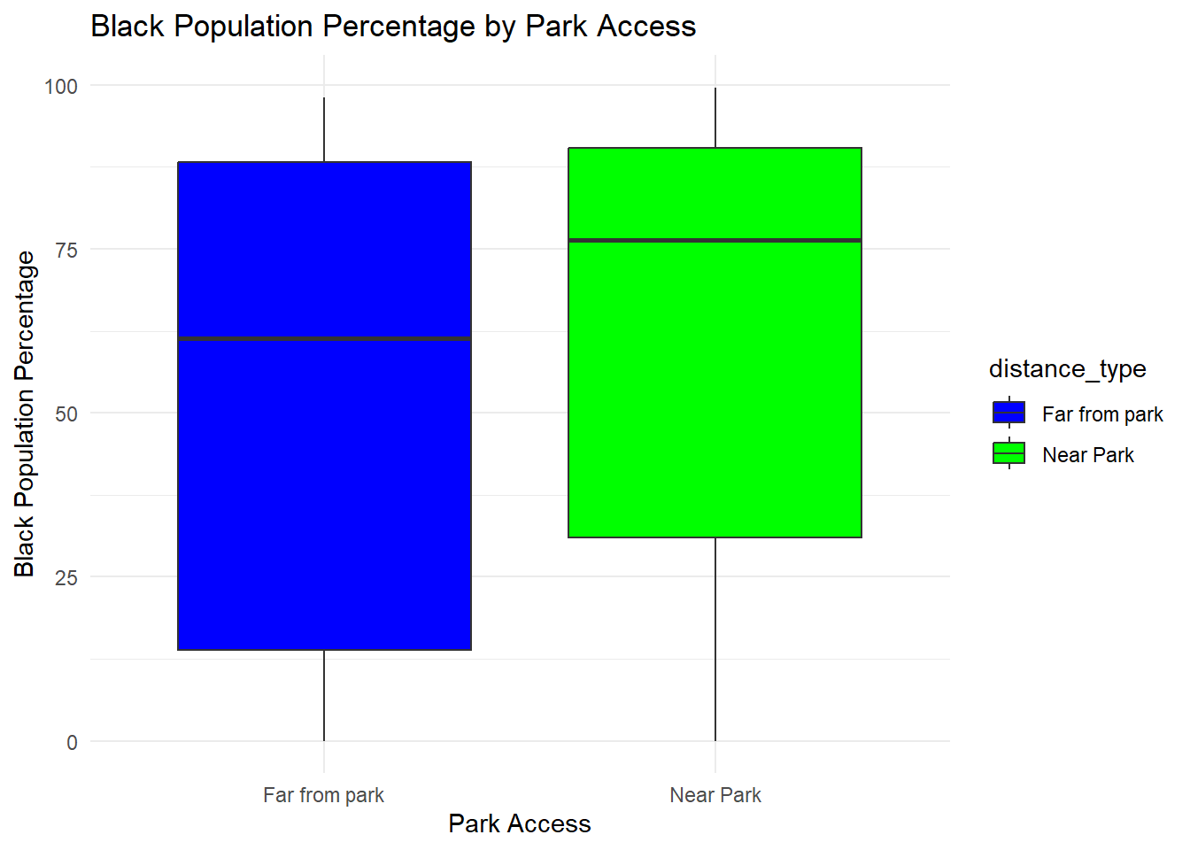
Tracts near parks have a slightly higher median Black population percentage.
Both "Near Park" and "Far from Park" categories show a wide range of percentages.
Tracts far from parks include some with very low Black population percentages.

Slide 11
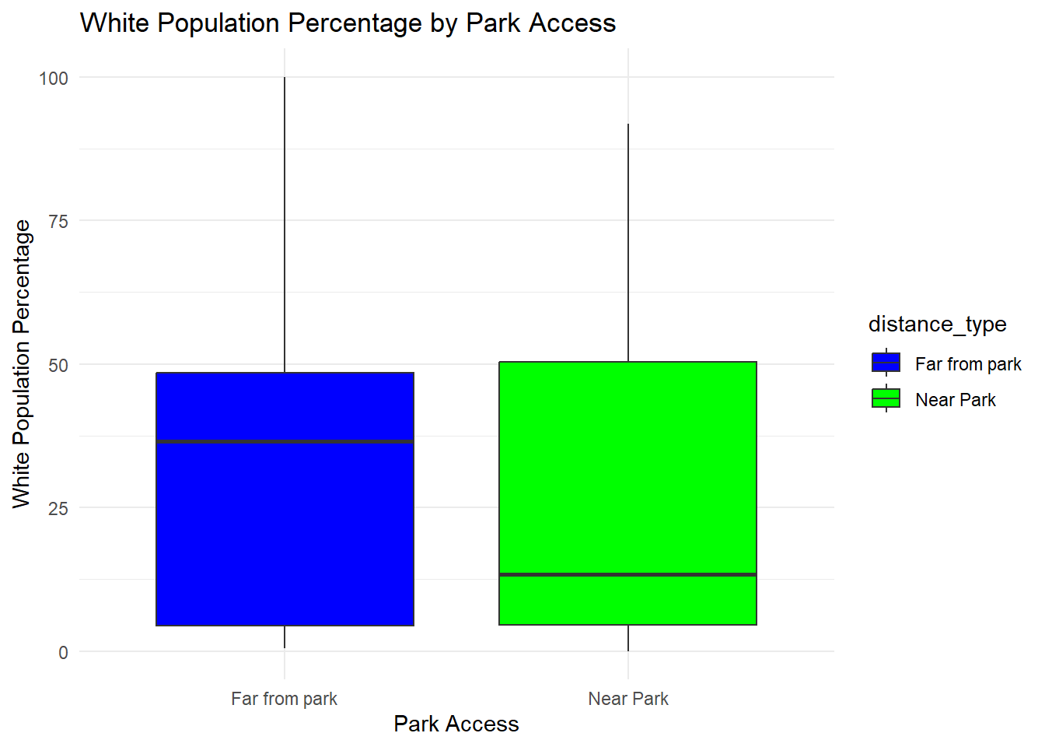
Tracts near parks have a lower median White population percentage compared to tracts far from parks.
Both categories show a wide range of White population percentages, with significant overlap.
Both "Near Park" and "Far from Park" categories include tracts with very high and very low White population percentages.

Slide 12
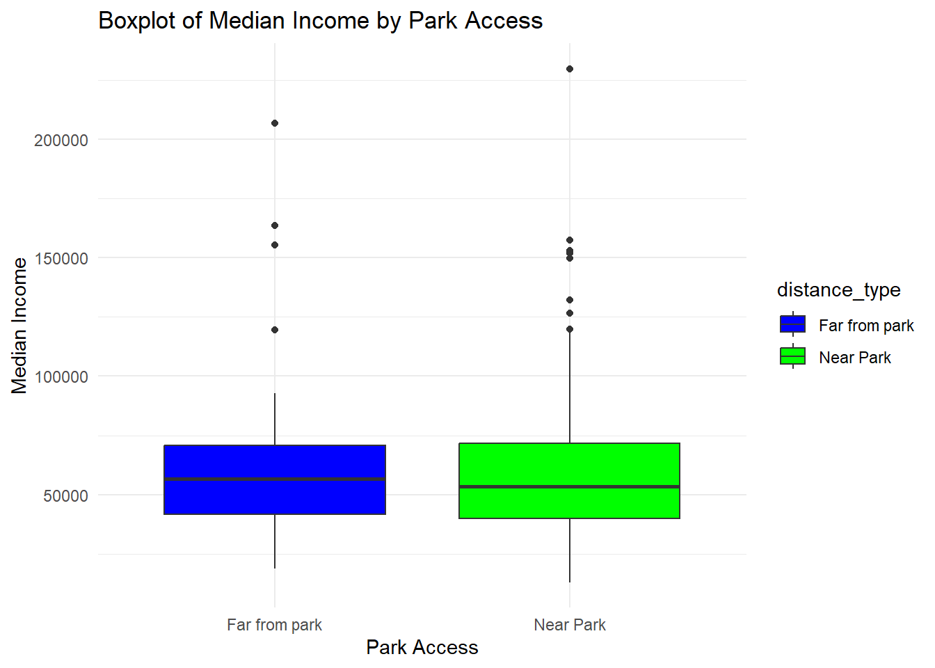
These findings suggest that, in Baltimore, proximity to parks does not significantly correlate with median household income. This could indicate equitable physical access to parks across different income levels.

Slide 13
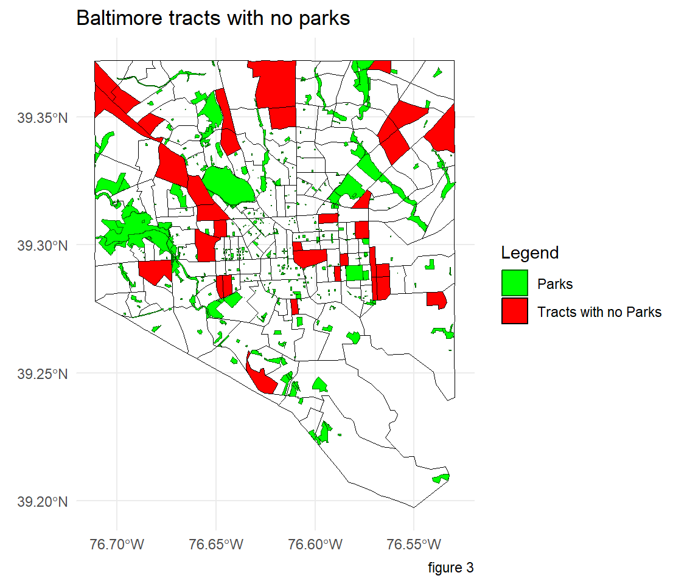
The red areas represent tracts in Baltimore that lack parks, highlighting gaps in park accessibility.
Green areas indicate the location of parks, showing that parks are unevenly distributed across the city.
There are noticeable clusters of tracts without parks,
particularly in central and northern Baltimore.
These red tracts could be prioritized for future green space development to improve accessibility and equity.

Slide 14
Isochrones are maps that show the areas reachable within a specific time frame from a given location, using different travel modes like walking, cycling, or driving.
I used isochrones to analyze park accessibility by examining the surrounding area in 5, 10, and 15-minute intervals. By preparing isochrones for a specific location (using its latitude and longitude), I was able to identify which parks are accessible within those time frames.
I applied three different travel modes(walking, cycling, and driving)to understand access from various perspectives. These isochrones can be used beyond just parks; they are also useful for identifying nearby emergency services, schools, grocery stores, and other important locations within a specified range.

Slide 15
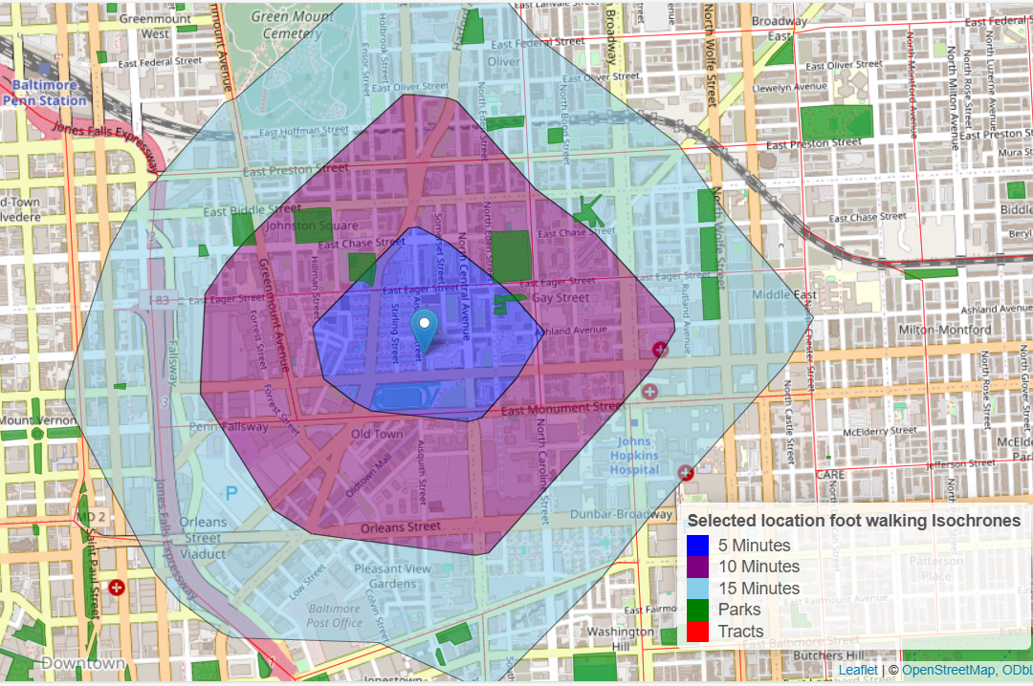
the leaflet maps shows the isochrones at 5, 10 and 15 min intervals, It shows the area coverage of isochrones, it is useful to check the available parks or any other place of interest around the desired location.
Few parks are accessible within the 5-minute walking range.
Isochrones highlight how street patterns influence walking accessibility.

Slide 16
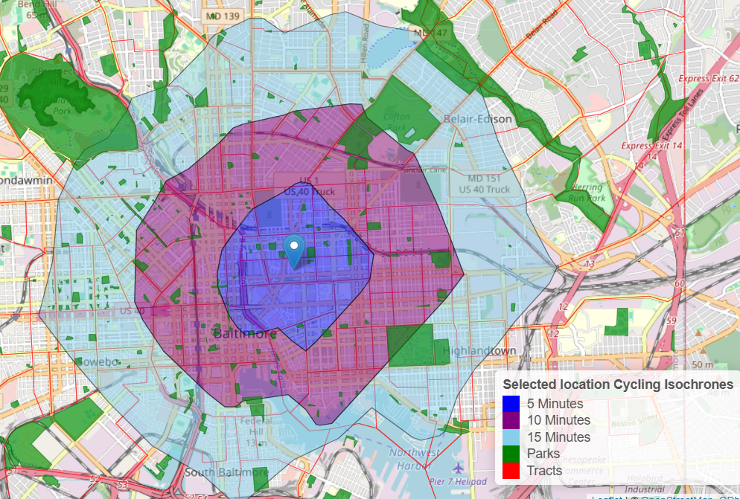
Cycling significantly increases the accessible area, including more parks within the 15-minute range.
Larger parks like Herring Run Park and others fall within the cycling range, improving access to recreational areas.
The isochrones illustrate how cycling infrastructure interacts with road networks to enhance mobility.

Slide 17
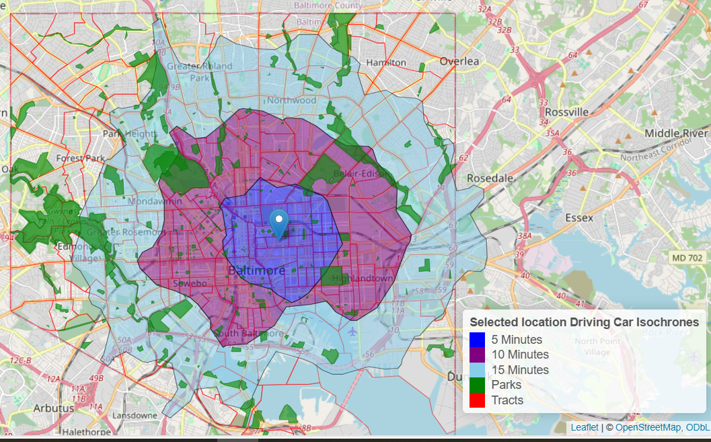
Covers a broad area within 15 minutes, reaching most of Baltimore.
Includes major parks like Forest Park and Clifton Park.
Highlights the role of driving in accessing distant green spaces.
Expands recreational opportunities beyond the urban

Slide 18
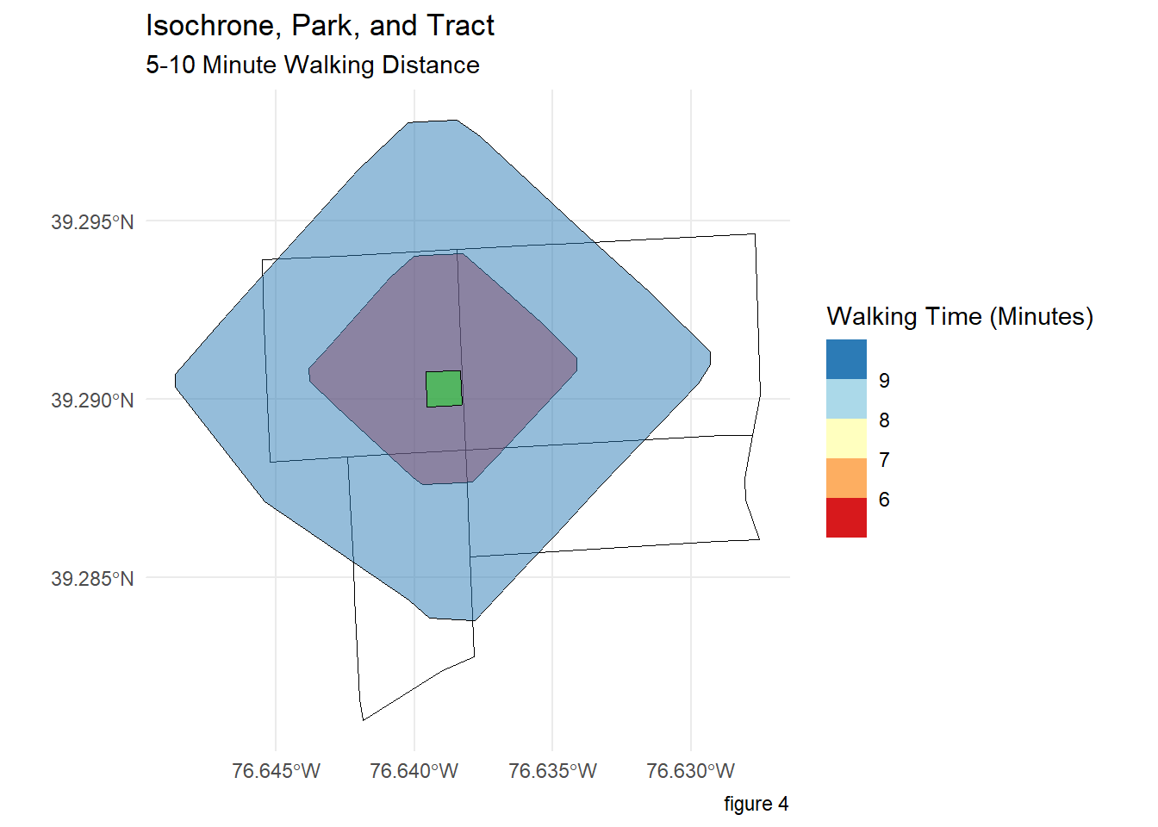
Calculating 5- and 10-minute isochrones for a park
The isochrones analysis highlights the park's influence in providing walkable access within a 5–10 minute radius.
The walking accessibility spans multiple tracts, demonstrating how far the park serves nearby residents

Slide 19
Conclusion
This project highlights disparities in Baltimore's park distribution. Central areas have small, accessible parks, while northern and southern parts have fewer, larger parks, with some tracts lacking any. Although Black communities tend to have better park access, limited park sizes restrict usability. Isochrones effectively analyze accessibility, identifying parks within 5- to 15-minute travel intervals across walking, cycling, and driving modes. This versatile approach can evaluate green space accessibility for any location comprehensively.
Who Might Benefit from My Project?
This project helps policymakers address park access gaps, supports advocacy for equitable resources, and highlights the health benefits of walkable parks, especially in dense or minority neighborhoods. Additionally, public health professionals can highlight the importance of walkable access to parks for improving physical and mental health, especially in neighborhoods with higher population densities or minority demographics.

Slide 20
Can Your Project Avoid Causing Any Harm to the Community?
The project takes a thoughtful approach to addressing park access in Baltimore, acknowledging that environmental improvements can reshape neighborhood dynamics in complex ways. By letting data tell the story of existing disparities and actively involving local residents in the conversation, the research aims to support meaningful improvements in access. The focus is on thoughtful development that lets more residents enjoy the benefits of parks - from family gatherings to exercise to quiet reflection
Suggesting a Policy Change
Target park development in underserved areas, particularly in tracts with high Black populations and limited green spaces. This focused approach addresses historical inequities while maximizing community impact.
Improve accessibility to existing parks by enhancing walkable infrastructure.
Plan proactively for future green spaces, especially in the northern and southern parts of Baltimore where development opportunities still exist. Learning from the current challenge of small, scattered parks in urban areas, these developing regions can prioritize setting aside larger spaces for parks early in their planning process.
Limitations:
MAUP: tracts are considered for analysis, so the emphasis is given to the census tracts. May not fully capture the socio-political processes influencing current disparities in green space access. Primarily addresses proximity and walkability, excluding factors like affordability, programming, or cultural inclusivity.

